Slide 1
The ribbon
The ribbon

Slide 2
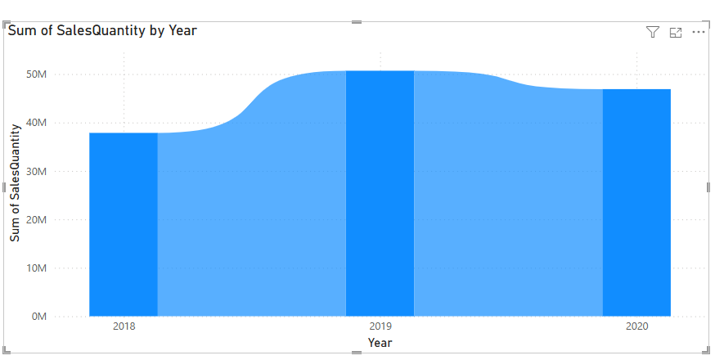
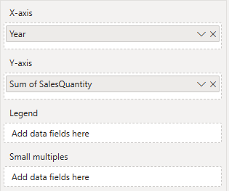
The ribbon
Note: This workshop is using Sales.xls of Excel Folder
Choose the Ribbon chart visual from the Visualizations pane, then add Year to X-Axis and SalesQuantity to
Y-Axis

Slide 3
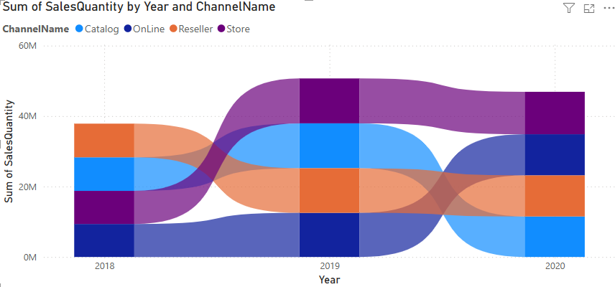
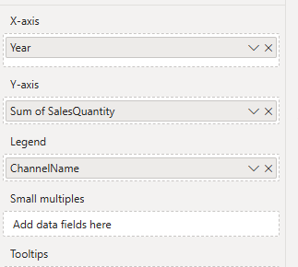
The ribbon
Then add the Channel Name to the Legend and observe the appearence change

Slide 4
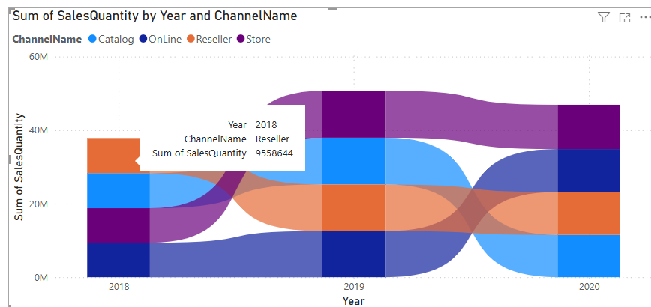
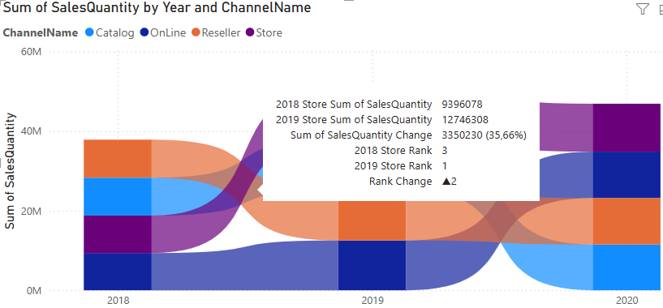
The ribbon
Hold the mouse over the orange bound and try to analyse the data

Slide 5
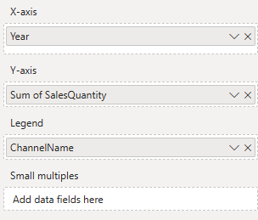
The ribbon
What is Small multiples in Power BI?
Small multiples allow you to create a series of mini-charts one per value of a field to compare performance side by side

Slide 6
The ribbon
Use it when you want to:
Compare trends across subgroups
Avoid over-cluttered charts
Preserve the same axis scales across all charts for easier comparison
It should be a field with a limited number of distinct values (less than 20 is ideal)
Example: Decomposing the main chart on mensual analysis charts

Slide 7
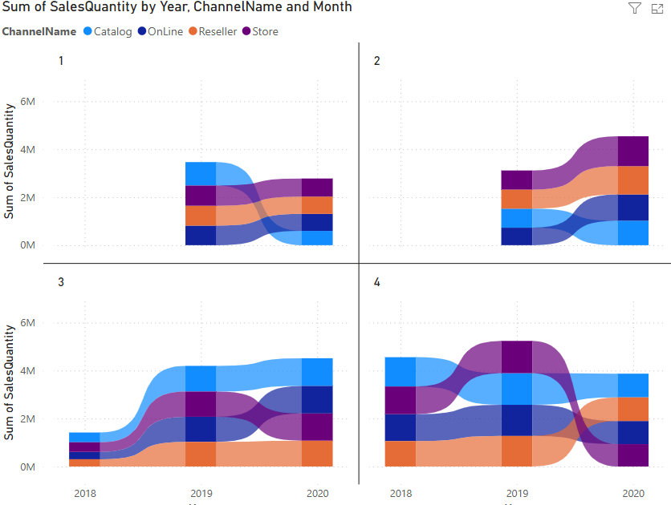
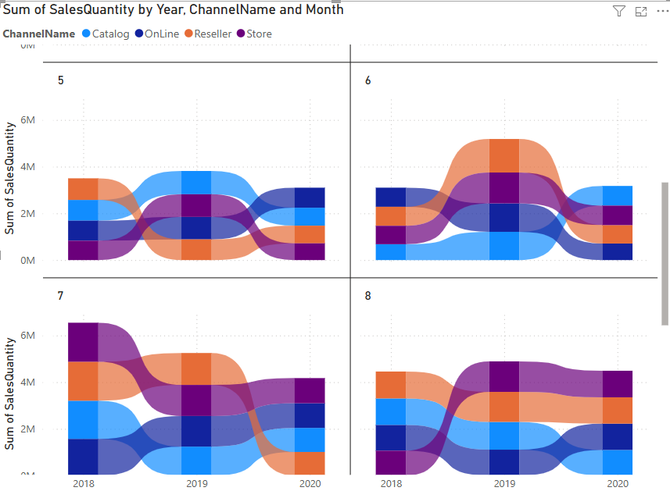
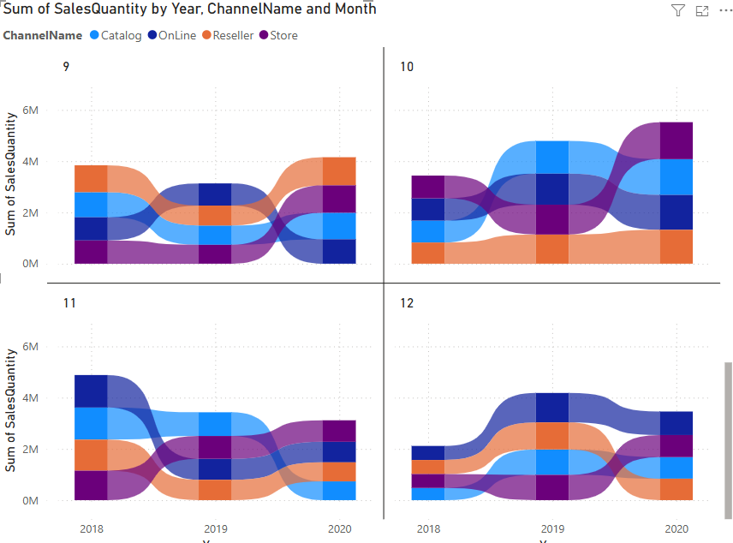
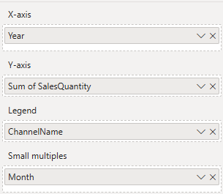
The ribbon

Slide 8
Thank you
Thank you

